Slide 1
Use Case design to increase 15 % Retail Sales in FMCG By Sree Charan, Mounica, Swetha, Manish and Rajesh

Slide 2
Project analysis slide 6
Introduction
A business that sells goods and services through outlets to consumers by providing them unlimited choice, outstanding value proposition, superior quality and unmatched experience.
.
Retailing is the one of the largest private sector in the world and 4th largest sector in the Indian economy.
Fast Moving Consumer Goods(FMCG) are the products that are sold quickly and at a relatively low cost.
Growing awareness, easier access and changing lifestyles have been the key growth drivers for the sector
FMCG sector has grown from US$ 31.6 billion in 2011 to US$ 52.75 billion in 2017-18. Urban segmentation accounted for 55% revenue and rural segmentation accounted for 45% revenue.
Three main segments in the sector – food and beverages which accounts for 19 per cent of the sector, healthcare which accounts for 31 per cent and household and personal care which accounts for the remaining 50 per cent.

Slide 3


FMCG Retail Supermarket

Slide 4

Project analysis slide 2
Attributes responsible for Sales
CUSTOMER
MARKETING
Sales
based
Attributes
OPERATIONS
MARKET COMPETITION

Slide 5

Project analysis slide 6
Issues and Sub-Issues
Customer
Customer Segmentation
Marketing
Customer Retention
Operations
Competition
Pricing
Inventory
Technology
Customer Acquisition
Customer Behavior
Merchandise Planning
Store Maintenance
Home Delivery

Slide 6
Customer

Slide 7
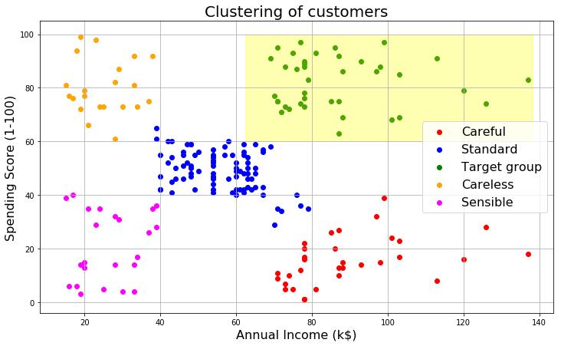
Project analysis slide 4
Customer
Customer Segmentation
Income
High Income
Customer
Customer Behaviour
Marital Status
Low Income
Recommendations
High Income – High Spending | Loyalty Cards
High Income – Low Spending | Discounts
Low Income – High Spending | Cashback
Low Income – Low Spending
Issue
Recommendations
Non Durables
Example

Slide 8
Project analysis slide 4
Customer
Customer Segmentation
Income
Single
Customer
Customer Behaviour
Marital Status
Family
Quantitative
diversification
Best Quality
Recommendation
Single
Issue
Implementation Plan
Issue
Recommendations
Non Durables
Family
Family customer buys more quantity and customer satisfaction
Marital Status
Example
Scope

Slide 9
Project analysis slide 4
Customer
Customer Segmentation
Gender
Customer
Customer Behaviour
Bundling
Product diversification
Club low sold goods with high sold goods
Recommendation
Gender
Issue
Implementation Plan
Issue
Recommendations
Turnover will be less due to diversification
Bundling promotes sales of
low sold goods
Non Durables
Customer Behaviour
Bundling
Example
Scope

Slide 10
Marketing

Slide 11
Project analysis slide 4
Marketing
Customer Retention
Customer
Customer Acquisition
Advertisement
Promotional offers for latest products
Cashback than discounts
Dhamaka Sales
Dealer commission distribution
Conventional marketing
Recommendation
Single
Issue
Implementation Plan
Issue
Recommendations
Non Durables
Customer Acquisition
Family
More customer footprint and business growth
Example
Scope

Slide 12
Project analysis slide 4
Marketing
Customer Retention
Customer Loyalty
Customer
Customer Acquisition
Reward Points based discounts
Complementary products
Monetary threshold based discounts
Recommendation
Single
Issue
Implementation Plan
Issue
Recommendations
Non Durables
Customer Retention
Family
Customer locking and customer loyalty
Example
Scope

Slide 13


Project analysis slide 4
Marketing
Do you know?
Issue
Recommendations
Non Durables
Example

Slide 14
Operations

Slide 15
Project analysis slide 4
Operations
Inventory
Stock Management
Packaged
Operations
Merchandise Planning
Stock Keeping Units
Unpackaged
Store Maintenance
Maintain groceries healthy and fresh to prevent Customer Attrition
Product quality of unpackaged goods like rice, dal etc.,
Recommendation
Packaged goods
Issue
Implementation Plan
Unpackaged
goods
Stock Management
Projects organisation commitment to customer
Example

Slide 16
Project analysis slide 4
Operations
Inventory
Stock Management
Heavy Goods
Operations
Merchandise Planning
Stock Keeping Units
Light Goods
Store Maintenance
Heavy Goods on lower level
Light Goods on upper level
Provide better shopping experience and easy picking of products
Recommendation
Heavy Goods
Issue
Implementation Plan
Stock Keeping Units
Light Goods
Customer satisfaction
Scope

Slide 17
Project analysis slide 4
Operations
Inventory
Branding
Operations
Merchandise Planning
Dealership
Store Maintenance
Work on Global Trends
Supply Chain Management
Best deals for organization and consumer
Identifies and differentiates a product from other products
Recommendation
Branding
Issue
Implementation Plan
Dealership
Customer commitment and customer efficiency
Merchandising
B2B selling of products
Example

Slide 18
Project analysis slide 4
Operations
Inventory
Packaging
Operations
Merchandise Planning
Illumination
Store Maintenance
Workforce
Simple and appealing packing
Bundling
Provide better product suggestions
Provide better shopping experience
Presentation of a product in an advantageous way
Recommendation
Packaging & Illumination
Issue
Implementation Plan
Store Maintenance
Workforce
Sells products and maintains the store
Quality of atmosphere
Scope

Slide 19
Competition

Slide 20
Project analysis slide 4
Competition
Pricing
Competition
Technology
New entrants in the market
At affordable price,
More Quantity
Best Quality
Recommendation
Durable
Issue
Implementation Plan
Non Durables
Pricing
New customer acquisition and old customer retention
Scope

Slide 21
Project analysis slide 4
Competition
Pricing
Competition
Technology
New entrants in the market
Latest technology for speed billing
Free wi-fi at billing counter
AI and deep learning models for customer recognition(New or old)
Digital Marketing
Recommendation
Durables
Issue
Implementation Plan
Non Durables
Technology
Scope
Enhancing customer experience and process simplification

Slide 22
Project analysis slide 4
Competition
Pricing
Competition
Technology
New entrants in the market
Mergers and Acquisitions
Increase in advertisement and seasonal promotions like world cup sale
Create market monopoly by offering large cashbacks
Recommendation
Issue
Implementation Plan
Non Durables
New entrants in the market
Customer acquisition and upscaling customer base
Scope

Slide 23
Project analysis slide 3
Ghost Pack
MARKET ANALYSIS
TECHNOLOGY
FINANCIAL ANALYSIS
ECONOMIC ANALYSIS
ECOLOGICAL ANALYSIS
It is important to understand the global market, consumer behavior and provide efficient service
Technology is going provide that breakthrough fostering the customer experience and analyze the customer needs and wants
Cash flow and Sales volume is the backbone of the retail business marathon.
Global market have indirect effect on sales like purchasing, inflation etc.,.
‘WE’ for ‘You’ campaign, healthcare and wellness products , zero carbon footprint(NO to PLASTIC)

Slide 24
Project analysis slide 8
SWOT Analysis
POSITIVE
NEGATIVE
STRENGTH
WEAKNESS
Customer trust and organization commitment
Customer service
Physical existence
High volume of sales
High operational costs
Waiting time near billing counter
Less margin
INTERNAL
OPPORTUNITY
THREAT
Own label products
Exclusive product offerings
Cross marketing
Digital marketing
E-commerce
New entrants
MNC
EXTERNAL

Slide 25
Thank You

